Slide 1
DDoS Attack & Defense
02
Kai Bu
kaibu@zju.edu.cn
http://list.zju.edu.cn/kaibu/netsec2022

Slide 2
DDoS?

Slide 3
DDoS?

Slide 4

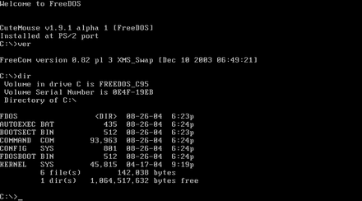
DDoS?
Notes:
DOS (/dɒs/, /dɔːs/) is a platform-independent acronym for disk operating system which later became a common shorthand for disk-based operating systems on IBM PC compatibles.
(kidding)

Slide 5
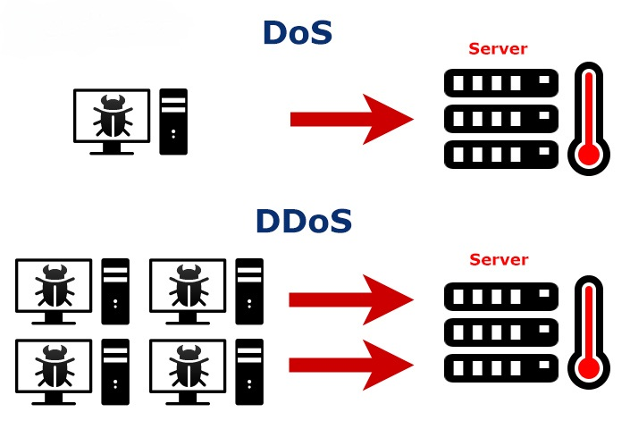
DDoS!
Denial-of-Service Attack:
control an attacking computer/device;
flood victim with superfluous requests;
overload victim and prevent it from fulfilling some legitimate requests;
Notes:
https://en.wikipedia.org/wiki/Denial-of-service_attack
In computing, a denial-of-service attack (DoS attack) is a cyber-attack in which the perpetrator seeks to make a machine or network resource unavailable to its intended users by temporarily or indefinitely disrupting services of a host connected to the Internet.
Denial of service is typically accomplished by flooding the targeted machine or resource with superfluous requests in an attempt to overload systems and prevent some or all legitimate requests from being fulfilled.

Slide 6
DDoS!?
Denial-of-Service Attack:
control an attacking computer/device;
flood victim with superfluous requests;
overload victim and prevent it from fulfilling some legitimate requests;
defense: block the attacking source
Notes:
https://en.wikipedia.org/wiki/Denial-of-service_attack
In computing, a denial-of-service attack (DoS attack) is a cyber-attack in which the perpetrator seeks to make a machine or network resource unavailable to its intended users by temporarily or indefinitely disrupting services of a host connected to the Internet.
Denial of service is typically accomplished by flooding the targeted machine or resource with superfluous requests in an attempt to overload systems and prevent some or all legitimate requests from being fulfilled.

Slide 7
DDoS!!
Distributed Denial-of-Service Attack:
control many different attacking sources;
make it harder to stop the attack simply by blocking a single source;
Notes:
https://en.wikipedia.org/wiki/Denial-of-service_attack
In a distributed denial-of-service attack (DDoS attack), the incoming traffic flooding the victim originates from many different sources. This effectively makes it impossible to stop the attack simply by blocking a single source.

Slide 8
DDoS!!
Distributed Denial-of-Service Attack:
how to attack?
how to defend?
Notes:
https://en.wikipedia.org/wiki/Denial-of-service_attack
In a distributed denial-of-service attack (DDoS attack), the incoming traffic flooding the victim originates from many different sources. This effectively makes it impossible to stop the attack simply by blocking a single source.

Slide 9
DDoS!!
Distributed Denial-of-Service Attack:
how to attack a network service?
Notes:
More specifically, the question would be how to attack a network service using ddos?
ping flood as an example

Slide 10
Ping Flood
Exploit Internet Control Messge Protocol (ICMP)
an internet layer protocol used by network devices to communicate;
also used by network diagnostic tools such as traceroute and ping;
ICMP Echo Request: sender to receiver
ICMP Echo Reply: receiver to sender
Notes:
https://www.cloudflare.com/learning/ddos/ping-icmp-flood-ddos-attack/
The Internet Control Message Protocol (ICMP), which is utilized in a Ping Flood attack, is an internet layer protocol used by network devices to communicate. The network diagnostic tools traceroute and ping both operate using ICMP. Commonly, ICMP echo-request and echo-reply messages are used to ping a network device for the purpose of diagnosing the health and connectivity of the device and the connection between the sender and the device.
An ICMP request requires some server resources to process each request and to send a response. The request also requires bandwidth on both the incoming message (echo-request) and outgoing response (echo-reply). The Ping Flood attack aims to overwhelm the targeted device’s ability to respond to the high number of requests and/or overload the network connection with bogus traffic. By having many devices in a botnet target the same internet property or infrastructure component with ICMP requests, the attack traffic is increased substantially, potentially resulting in a disruption of normal network activity. Historically, attackers would often spoof in a bogus IP address in order to mask the sending device. With modern botnet attacks, the malicious actors rarely see the need to mask the bot’s IP, and instead rely on a large network of un-spoofed bots to saturate a target’s capacity.
The DDoS form of a Ping (ICMP) Flood can be broken down into 2 repeating steps:
The attacker sends many ICMP echo request packets to the targeted server using multiple devices.
The targeted server then sends an ICMP echo reply packet to each requesting device’s IP address as a response.

Slide 11
Ping Flood
Attack principle
both incoming ICMP Echo Request and outgoing ICMP Echo Reply consume bandwidth;
overwhelm the target device’s ability to respond to a high number of requests
and/or overload the network connection with bogus traffic
Notes:
https://www.cloudflare.com/learning/ddos/ping-icmp-flood-ddos-attack/
The Internet Control Message Protocol (ICMP), which is utilized in a Ping Flood attack, is an internet layer protocol used by network devices to communicate. The network diagnostic tools traceroute and ping both operate using ICMP. Commonly, ICMP echo-request and echo-reply messages are used to ping a network device for the purpose of diagnosing the health and connectivity of the device and the connection between the sender and the device.
An ICMP request requires some server resources to process each request and to send a response. The request also requires bandwidth on both the incoming message (echo-request) and outgoing response (echo-reply). The Ping Flood attack aims to overwhelm the targeted device’s ability to respond to the high number of requests and/or overload the network connection with bogus traffic. By having many devices in a botnet target the same internet property or infrastructure component with ICMP requests, the attack traffic is increased substantially, potentially resulting in a disruption of normal network activity. Historically, attackers would often spoof in a bogus IP address in order to mask the sending device. With modern botnet attacks, the malicious actors rarely see the need to mask the bot’s IP, and instead rely on a large network of un-spoofed bots to saturate a target’s capacity.
The DDoS form of a Ping (ICMP) Flood can be broken down into 2 repeating steps:
The attacker sends many ICMP echo request packets to the targeted server using multiple devices.
The targeted server then sends an ICMP echo reply packet to each requesting device’s IP address as a response.

Slide 12
Ping Flood
Attack principle
The attacker sends many ICMP echo request packets to the targeted server using multiple devices;
The targeted server then sends an ICMP echo reply packet to each requesting device’s IP address as a response.
Notes:
https://www.cloudflare.com/learning/ddos/ping-icmp-flood-ddos-attack/
The Internet Control Message Protocol (ICMP), which is utilized in a Ping Flood attack, is an internet layer protocol used by network devices to communicate. The network diagnostic tools traceroute and ping both operate using ICMP. Commonly, ICMP echo-request and echo-reply messages are used to ping a network device for the purpose of diagnosing the health and connectivity of the device and the connection between the sender and the device.
An ICMP request requires some server resources to process each request and to send a response. The request also requires bandwidth on both the incoming message (echo-request) and outgoing response (echo-reply). The Ping Flood attack aims to overwhelm the targeted device’s ability to respond to the high number of requests and/or overload the network connection with bogus traffic. By having many devices in a botnet target the same internet property or infrastructure component with ICMP requests, the attack traffic is increased substantially, potentially resulting in a disruption of normal network activity. Historically, attackers would often spoof in a bogus IP address in order to mask the sending device. With modern botnet attacks, the malicious actors rarely see the need to mask the bot’s IP, and instead rely on a large network of un-spoofed bots to saturate a target’s capacity.
The DDoS form of a Ping (ICMP) Flood can be broken down into 2 repeating steps:
The attacker sends many ICMP echo request packets to the targeted server using multiple devices.
The targeted server then sends an ICMP echo reply packet to each requesting device’s IP address as a response.

Slide 13
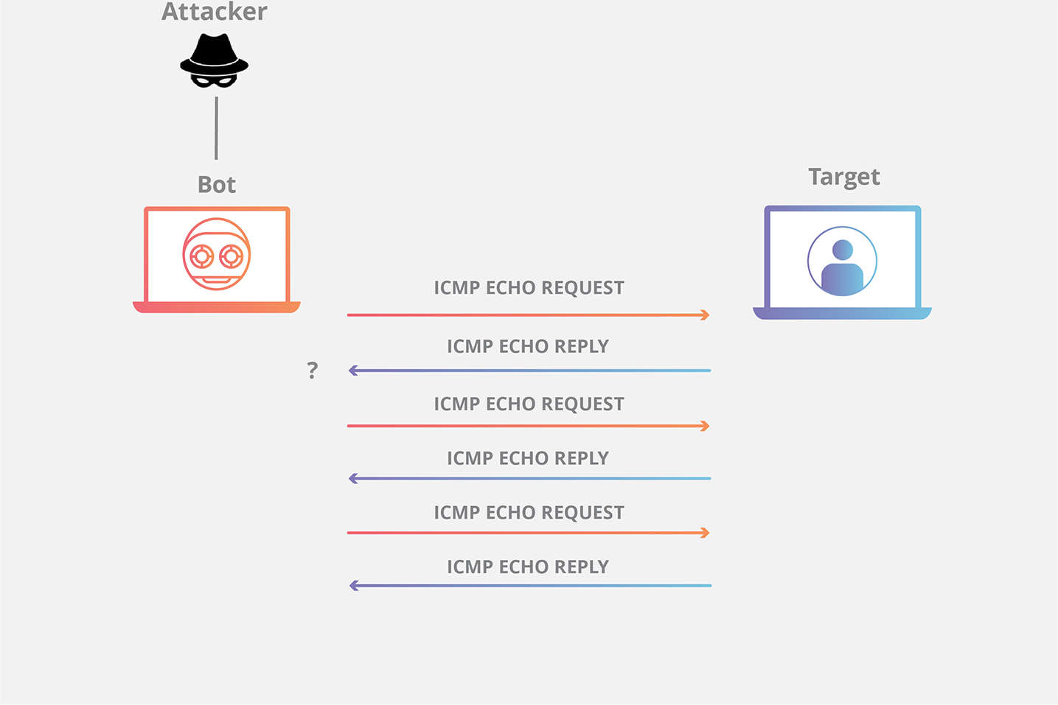
Ping Flood
https://www.cloudflare.com/learning/ddos/ping-icmp-flood-ddos-attack/
Notes:
https://www.cloudflare.com/learning/ddos/ping-icmp-flood-ddos-attack/
The Internet Control Message Protocol (ICMP), which is utilized in a Ping Flood attack, is an internet layer protocol used by network devices to communicate. The network diagnostic tools traceroute and ping both operate using ICMP. Commonly, ICMP echo-request and echo-reply messages are used to ping a network device for the purpose of diagnosing the health and connectivity of the device and the connection between the sender and the device.
An ICMP request requires some server resources to process each request and to send a response. The request also requires bandwidth on both the incoming message (echo-request) and outgoing response (echo-reply). The Ping Flood attack aims to overwhelm the targeted device’s ability to respond to the high number of requests and/or overload the network connection with bogus traffic. By having many devices in a botnet target the same internet property or infrastructure component with ICMP requests, the attack traffic is increased substantially, potentially resulting in a disruption of normal network activity. Historically, attackers would often spoof in a bogus IP address in order to mask the sending device. With modern botnet attacks, the malicious actors rarely see the need to mask the bot’s IP, and instead rely on a large network of un-spoofed bots to saturate a target’s capacity.
The DDoS form of a Ping (ICMP) Flood can be broken down into 2 repeating steps:
The attacker sends many ICMP echo request packets to the targeted server using multiple devices.
The targeted server then sends an ICMP echo reply packet to each requesting device’s IP address as a response.

Slide 14
Ping Flood
Attack principle
saturate the target device’s capacity by sending many requests;
Solution
disable the ICMP functionality of the target device;
(make the device unresponsive to ping requests and traceroute requests)
Notes:
https://www.cloudflare.com/learning/ddos/ping-icmp-flood-ddos-attack/
How is a Ping flood attack mitigated?
Disabling a ping flood is most easily accomplished by disabling the ICMP functionality of the targeted router, computer or other device. A network administrator can access the administrative interface of the device and disable its ability to send and receive any requests using the ICMP, effectively eliminating both the processing of the request and the Echo Reply. The consequence of this is that all network activities that involve ICMP are disabled, making the device unresponsive to ping requests, traceroute requests, and other network activities.

Slide 15
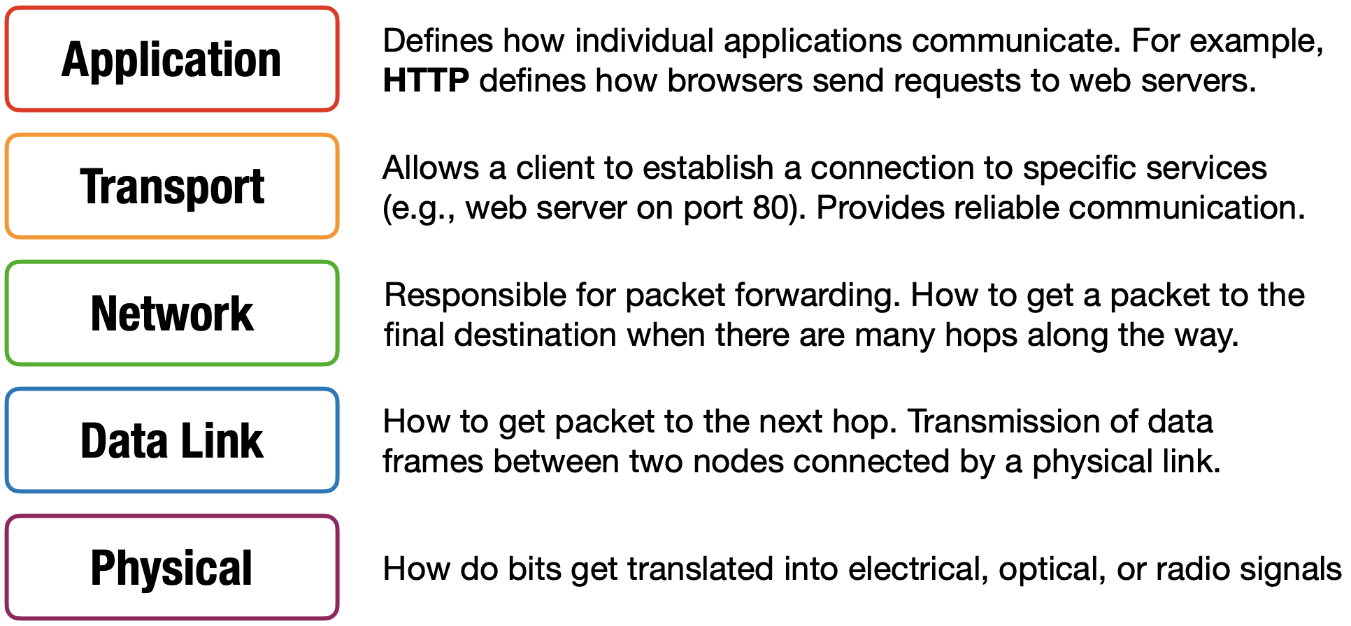
OSI 5 Layer Model
examples from https://cs155.stanford.edu/lectures/13-internet-protocols.pdf
Notes:
After showcasing ddos attack using ping flood as an example
discuss more examples across various layers of a network
The Open Systems Interconnection model (OSI model) is a conceptual model that characterises and standardises the communication functions of a telecommunication or computing system without regard to its underlying internal structure and technology.

Slide 16
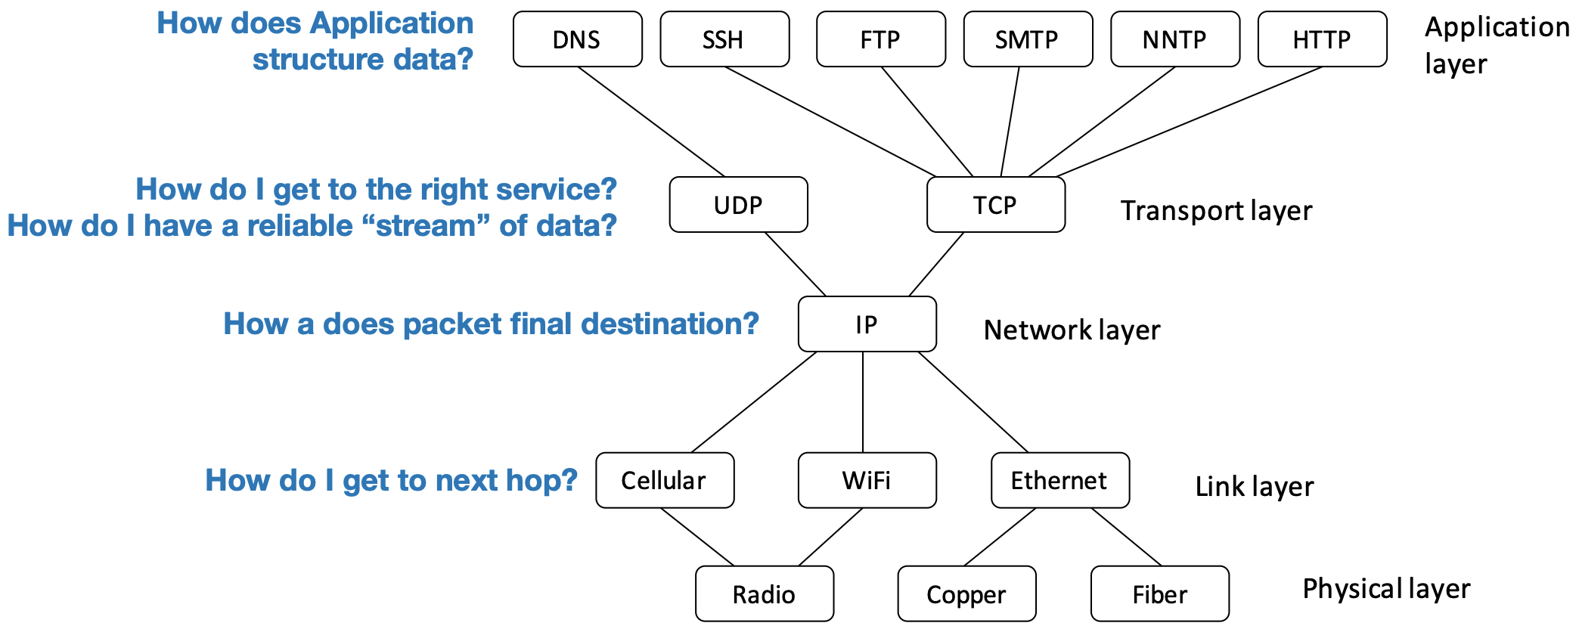
OSI 5 Layer Model
How do I get to final destination?

Slide 17
OSI 5 Layer Model
How do I get to final destination?
how to ddos at each layer?

Slide 18
OSI 5 Layer Model
How do I get to final destination?
link/IP layer:
send too much traffic for switches/routers to handle

Slide 19
OSI 5 Layer Model
How do I get to final destination?
transport layer:
require servers to maintain large number of concurrent connections or state

Slide 20
OSI 5 Layer Model
How do I get to final destination?
application layer:
require servers to perform expensive queries or cryptographic operations

Slide 21

OSI 5 Layer Model
How do I get to final destination?

Slide 22
TCP Handshake
C
S
SYN:
SN_{C}←rand_{C}
Listening
SN_{S}←rand_{S}
AN_{S}←SN_{C}+1
Store SN_{C} , SN_{S}
SYN/ACK:
Wait
SN←SN_{C}+1
AN←SN_{S}+1
ACK:
Established

Slide 23
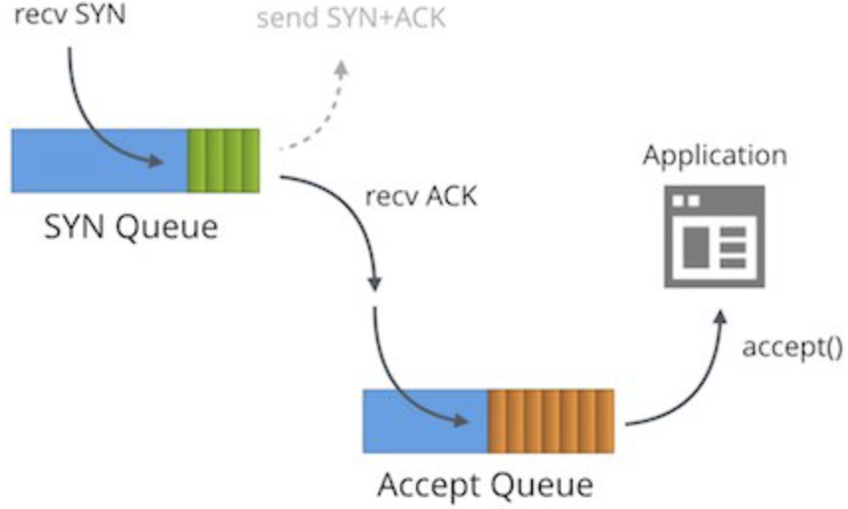
TCP Handshake
C
S
SYN:
SN_{C}←rand_{C}
Listening
SN_{S}←rand_{S}
AN_{S}←SN_{C}+1
Store SN_{C} , SN_{S}
SYN/ACK:
Wait
SN←SN_{C}+1
AN←SN_{S}+1
ACK:
Established

Slide 24
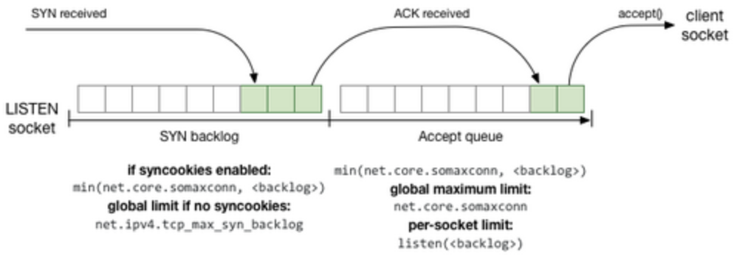
TCP Handshake
C
S
SYN:
SN_{C}←rand_{C}
Listening
SN_{S}←rand_{S}
AN_{S}←SN_{C}+1
Store SN_{C} , SN_{S}
SYN/ACK:
Wait
SN←SN_{C}+1
AN←SN_{S}+1
ACK:
Established

Slide 25
TCP SYN Flood
C
S
Single machine:
SYN packets with random source IP addresses
Fill up backlog queue on server
No further connections possible
SYN_{C1}
SYN_{C2}
SYN_{C3}
SYN_{C4}
SYN_{C5}

Slide 26
TCP SYN Flood
C
S
IP Spoofing:
SYN packets with random source IP addresses
Fill up backlog queue on server
No further connections possible
SYN_{C1}
SYN_{C2}
SYN_{C3}
SYN_{C4}
SYN_{C5}
Notes:
IP Spoofing: Craft SYN packets from randomly forged IP address;
For such random IP addresses, after they receive SYN ACK packets from the server, they may simply discard them as these IP addresses have not sent SYN requests at all

Slide 27
TCP SYN Flood
Queue size
commonly set as 128 by default on some Linux systems;
Timeout
evict a backlog entry if no ack is received until timeout, e.g., 3 mins
Attack example:
attacker sends 128 SYN every 3 mins without responding with ACK pkts

Slide 28
TCP SYN Flood
Attack principle
server commits resources (memory) before confirming identify of client (when client responds)
Solution?

Slide 29
TCP SYN Flood
Attack principle
server commits resources (memory) before confirming identify of client (when client responds)
Solution?
increase backlog queue size

Slide 30
TCP SYN Flood
Attack principle
server commits resources (memory) before confirming identify of client (when client responds)
Solution?
increase backlog queue size
attacker sends more SYN packets!

Slide 31
TCP SYN Flood
Attack principle
server commits resources (memory) before confirming identify of client (when client responds)
Solution?
decrease timeout

Slide 32
TCP SYN Flood
Attack principle
server commits resources (memory) before confirming identify of client (when client responds)
Solution?
decrease timeout
interrupt normal service requests!

Slide 33
SYN Cookies
Goal
avoid state storage on server
until 3-way handshake completes
Idea
server sends necessary states to client along with SYN-ACK;
client sends these states back to server along with ACK;

Slide 34
SYN Cookies
C
S
SYN:
SN_{C}←rand_{C}
Listening
SN_{S}←rand_{S}
AN_{S}←SN_{C}+1
Store SN_{C} , SN_{S}
SYN/ACK:
Wait
SN←SN_{C}+1
AN←SN_{S}+1
ACK:
Established
traditional TCP handshake

Slide 35
SYN Cookies
C
S
SYN:
SN_{C}←rand_{C}
Listening
SN_{S}←rand_{S}
AN_{S}←SN_{C}+1
Store SN_{C} , SN_{S}
SYN/ACK:
Store SN_{C} , SN_{S}
traditional TCP handshake

Slide 36
SYN Cookies
C
S
SYN:
SN_{C}←rand_{C}
Listening
SYN/ACK:
SN_{S}←(T||M||L)
Store none info
Send SN_{S} to client
SYN cookies

Slide 37
SYN Cookies
C
S
SYN:
SN_{C}←rand_{C}
Listening
SYN/ACK:
SN_{S}←(T||M||L)
Store none info
Send SN_{S} to client
T: 5-bit timestamp
time() logically right-shifted 6 positions;
64-second resolution;
SYN cookies

Slide 38
SYN Cookies
C
S
SYN:
SN_{C}←rand_{C}
Listening
SYN/ACK:
SN_{S}←(T||M||L)
Store none info
Send SN_{S} to client
M: 3-bit MSS
maximum segment size
SYN cookies

Slide 39
SYN Cookies
C
S
SYN:
SN_{C}←rand_{C}
Listening
SYN/ACK:
SN_{S}←(T||M||L)
Store none info
Send SN_{S} to client
L: 24-bit keyed hash
L = MAC_{key}(SAddr, SPort, DAddr, DPort, SN_{C}, T)
SYN cookies

Slide 40
SYN Cookies
C
S
SYN:
SN_{C}←rand_{C}
Listening
SYN/ACK:
SN_{S}←(T||M||L)
Store none info
Send SN_{S} to client
5 + 3 + 24 = 32 bits
SYN cookies

Slide 41
SYN Cookies
C
S
SYN:
SN_{C}←rand_{C}
Listening
SYN/ACK:
SN_{S}←(T||M||L)
Store none info
Send SN_{S} to client
5 + 3 + 24 = 32 bits
SN←SN_{C}+1
AN←SN_{S}+1
ACK:
Recover SN_{c}, SN_{s}
Verify SN_{s}
SYN cookies

Slide 42
SYN Cookies
L = MAC_{key}(SAddr, SPort, DAddr, DPort, SN_{C}, T)
C
S
SYN:
SN_{C}←rand_{C}
Listening
SYN/ACK:
SN_{S}←(T||M||L)
Store none info
Send SN_{S} to client
5 + 3 + 24 = 32 bits
SN←SN_{C}+1
AN←SN_{S}+1
ACK:
Recover SN_{c}, SN_{s}
Recompute SN_{s}
SYN cookies

Slide 43
SYN Cookies
C
S
SYN:
SN_{C}←rand_{C}
Listening
SYN/ACK:
SN_{S}←(T||M||L)
Store none info
Send SN_{S} to client
5 + 3 + 24 = 32 bits
SN←SN_{C}+1
AN←SN_{S}+1
ACK:
Established
if SN_{s} is valid
SYN cookies
Notes:
How to detect?

Slide 44
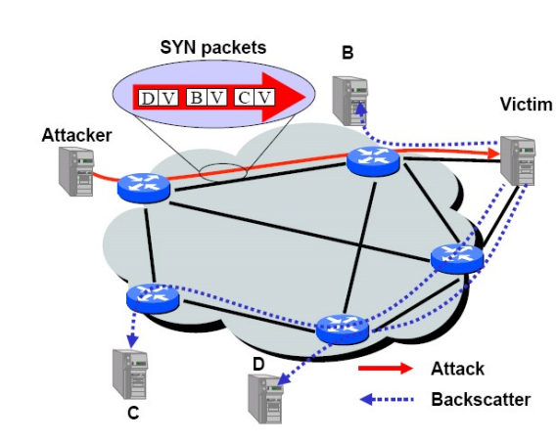
TCP SYN Flood Backscatter
SYN with forged source IP ⇒ SYN-ACK to random host
Notes:
For detection:
Since syn flood uses forged source IP, then responses to those forged IPs get no further responses;

Slide 45
TCP SYN Flood Backscatter
SYN with forged source IP ⇒ SYN-ACK to random host
backscatter packets can be used for detecting DDoS
Notes:
For detection
DV, BV, CV: D to Victim, B/C to Victim

Slide 46
DDoS attacks so far

Slide 47
Ping Flood
1 request vs 1 reply
https://www.cloudflare.com/learning/ddos/ping-icmp-flood-ddos-attack/
Notes:
https://www.cloudflare.com/learning/ddos/ping-icmp-flood-ddos-attack/
The Internet Control Message Protocol (ICMP), which is utilized in a Ping Flood attack, is an internet layer protocol used by network devices to communicate. The network diagnostic tools traceroute and ping both operate using ICMP. Commonly, ICMP echo-request and echo-reply messages are used to ping a network device for the purpose of diagnosing the health and connectivity of the device and the connection between the sender and the device.
An ICMP request requires some server resources to process each request and to send a response. The request also requires bandwidth on both the incoming message (echo-request) and outgoing response (echo-reply). The Ping Flood attack aims to overwhelm the targeted device’s ability to respond to the high number of requests and/or overload the network connection with bogus traffic. By having many devices in a botnet target the same internet property or infrastructure component with ICMP requests, the attack traffic is increased substantially, potentially resulting in a disruption of normal network activity. Historically, attackers would often spoof in a bogus IP address in order to mask the sending device. With modern botnet attacks, the malicious actors rarely see the need to mask the bot’s IP, and instead rely on a large network of un-spoofed bots to saturate a target’s capacity.
The DDoS form of a Ping (ICMP) Flood can be broken down into 2 repeating steps:
The attacker sends many ICMP echo request packets to the targeted server using multiple devices.
The targeted server then sends an ICMP echo reply packet to each requesting device’s IP address as a response.

Slide 48
TCP SYN Flood
C
S
Single machine:
SYN packets with random source IP addresses
Fill up backlog queue on server
No further connections possible
SYN_{C1}
SYN_{C2}
SYN_{C3}
SYN_{C4}
SYN_{C5}
1 SYN vs 1 SYN-ACK

Slide 49
asymmetric DDoS attack
the amount of bandwidth the targeted device consumes is simply the sum of the total traffic sent from each attacker/bot;

Slide 50
asymmetric DDoS attack
the attacker requires a substantial amount of traffic to succeed;
how to attack with less effort?

Slide 51
asymmetric DDoS attack
a relatively small number or low levels of resources are required by an attacker to cause a significantly greater number or higher level of target resources to malfunction or fail
Notes:
https://www.radware.com/security/ddos-knowledge-center/ddospedia/asymmetric-attack

Slide 52
Smurf Attack
Amplify the effect of ping flood
Exploit IP broadcast address
Forward the single ICMP Echo Request to any other hosts in the same network
Each host responds with an ICMP Echo Reply
1 request vs many replies
Notes:
https://www.cloudflare.com/learning/ddos/smurf-ddos-attack/

Slide 53
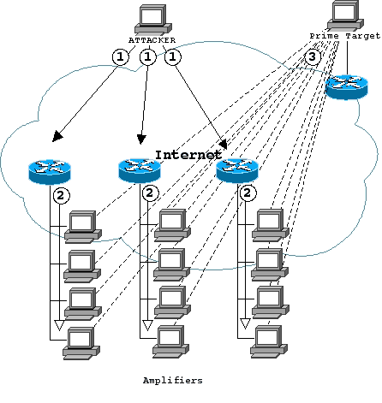
Smurf Attack
Amplify the effect of ping flood
1 request vs many replies
router and firewall
as amplifier
shorturl.at/iBDQR
Notes:
https://searchnetworking.techtarget.com/tip/Router-Expert-Smurf-fraggle-attack-defense-using-SACLs

Slide 54

Smurf Attack
Attack with an ICMP Echo Request with spoofed source IP address of the targeted server and destination IP address of an IP broadcast address
1 ICMP Echo Request
Spoofed Src: DDos Target
Dest: brdct addr
3 ICMP Echo Reply
Dest: DDos Target
router/firewall
DDoS
Target
DDoS
Source
Notes:
https://www.cloudflare.com/learning/ddos/smurf-ddos-attack/
https://searchnetworking.techtarget.com/tip/Router-Expert-Smurf-fraggle-attack-defense-using-SACLs
Here's How a Smurf attack works:
First the Smurf malware builds a spoofed packet that has its source address set to the real IP address of the targeted victim.
The packet is then sent to an IP broadcast address of a router or firewall, which in turn sends requests to every host device address inside the broadcasting network, increasing the number of requests by the number of networked devices on the network.
Each device inside the network receives the request from the broadcaster and then responds to the spoofed address of the target with an ICMP Echo Reply packet.
The target victim then receives a deluge of ICMP Echo Reply packets, potentially becoming overwhelmed and resulting in denial-of-service to legitimate traffic.

Slide 55
Smurf Attack
Solution
disable IP broadcast addresses on router and firewall, or
reject external packets to brdct addr
1 ICMP Echo Request
Spoofed Src: DDos Target
Dest: brdct addr
3 ICMP Echo Reply
Dest: DDos Target
router/firewall
DDoS
Target
DDoS
Source
Notes:
https://www.cloudflare.com/learning/ddos/smurf-ddos-attack/
https://searchnetworking.techtarget.com/tip/Router-Expert-Smurf-fraggle-attack-defense-using-SACLs
Here's How a Smurf attack works:
First the Smurf malware builds a spoofed packet that has its source address set to the real IP address of the targeted victim.
The packet is then sent to an IP broadcast address of a router or firewall, which in turn sends requests to every host device address inside the broadcasting network, increasing the number of requests by the number of networked devices on the network.
Each device inside the network receives the request from the broadcaster and then responds to the spoofed address of the target with an ICMP Echo Reply packet.
The target victim then receives a deluge of ICMP Echo Reply packets, potentially becoming overwhelmed and resulting in denial-of-service to legitimate traffic.

Slide 56
asymmetric DDoS attack
any other amplifiers?
Notes:
https://www.radware.com/security/ddos-knowledge-center/ddospedia/asymmetric-attack

Slide 57
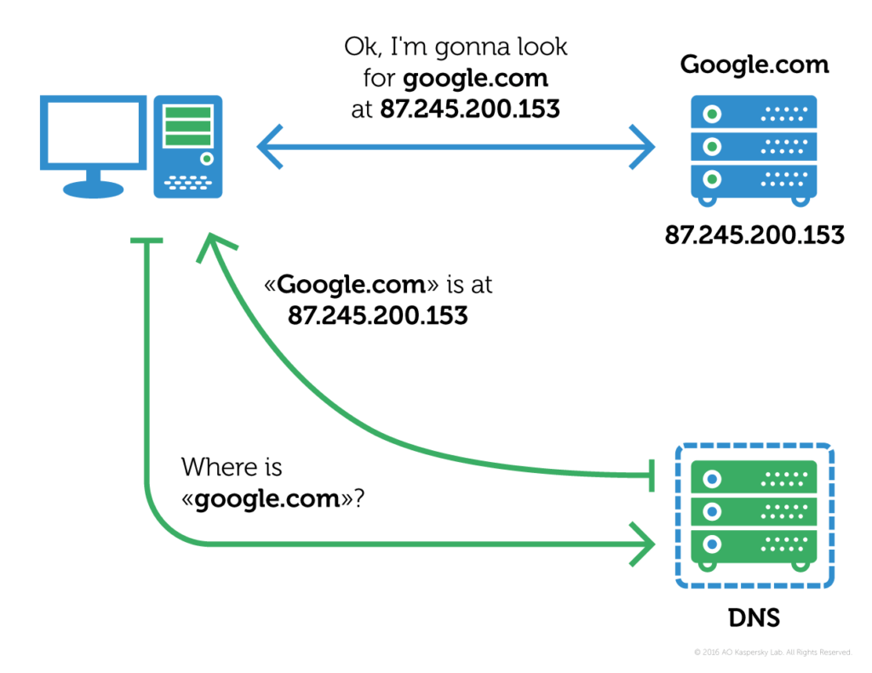
DNS Resolver
3
2
1
Notes:
DNS resolution. Each web server (and indeed any host connected to the internet) has a unique IP address in textual form, translating it to an IP address is a process known as DNS resolution or DNS lookup; here DNS stands for Domain Name Service.

Slide 58
DNS Amplification Attack
Leverage open DNS resolvers
Exploit DNS query of type ANY that retrieves all the available types for a given name
Notes:
https://www.cloudflare.com/learning/ddos/dns-amplification-ddos-attack/
An "open DNS resolver" is a DNS server that's willing to resolve recursive DNS lookups for anyone on the internet.

Slide 59
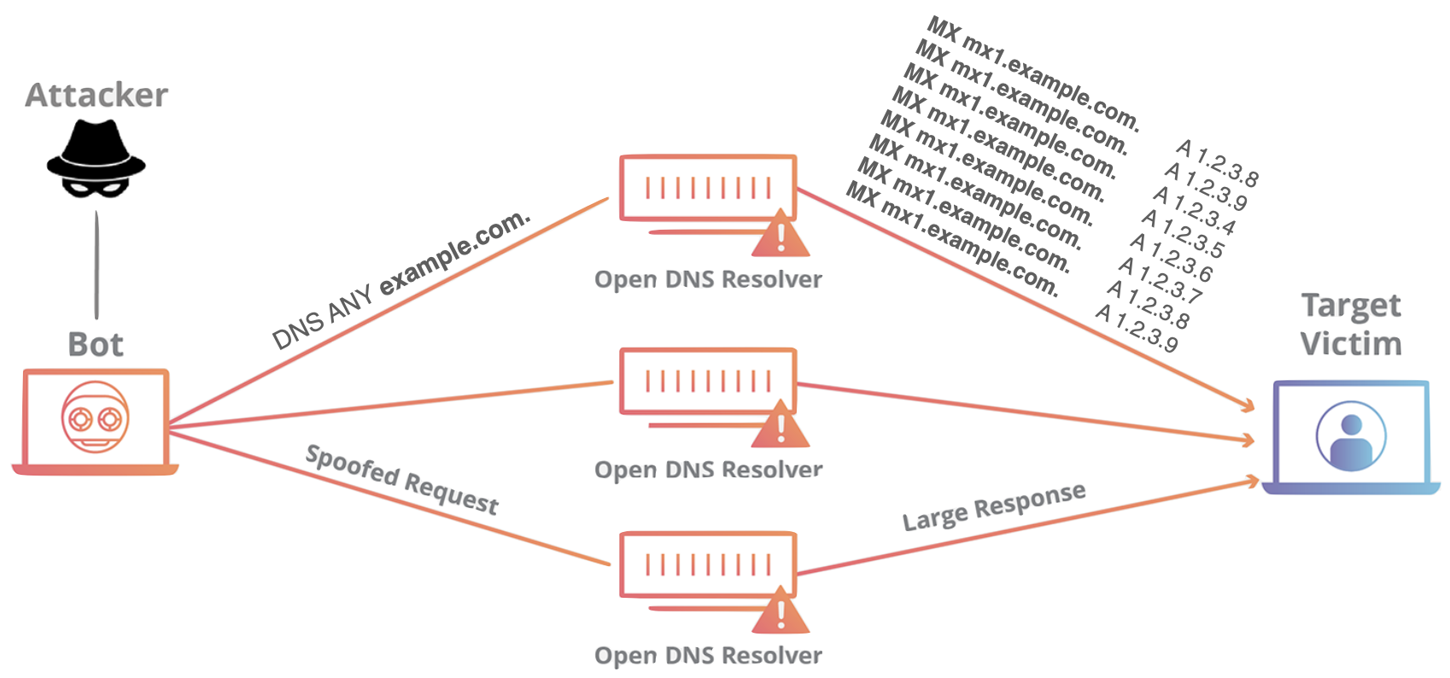
DNS Amplification Attack
Amplify the effect of DNS query
1 query vs many responses
Notes:
https://www.cloudflare.com/learning/ddos/dns-amplification-ddos-attack/
An "open DNS resolver" is a DNS server that's willing to resolve recursive DNS lookups for anyone on the internet.
A DNS amplification can be broken down into four steps:
The attacker uses a compromised endpoint to send UDP packets with spoofed IP addresses to a DNS recursor. The spoofed address on the packets points to the real IP address of the victim.
Each one of the UDP packets makes a request to a DNS resolver, often passing an argument such as “ANY” in order to receive the largest response possible.
After receiving the requests, the DNS resolver, which is trying to be helpful by responding, sends a large response to the spoofed IP address.
The IP address of the target receives the response and the surrounding network infrastructure becomes overwhelmed with the deluge of traffic, resulting in a denial-of-service.

Slide 60
DNS Amplification Attack
Attack with an ANY-type DNS query with spoofed source IP address of the targeted server
DNS Query
Spoofed SrcIP: DDos Target
(60 bytes)
EDNS Reponse
(3000 bytes)
DDoS
Source
DNS
Server
DDoS
Target
Notes:
https://www.cloudflare.com/learning/ddos/dns-amplification-ddos-attack/
An "open DNS resolver" is a DNS server that's willing to resolve recursive DNS lookups for anyone on the internet.
https://en.wikipedia.org/wiki/Extension_Mechanisms_for_DNS

Slide 61
DNS Amplification Attack
Attack with an ANY-type DNS query with spoofed source IP address of the targeted server
EDNS: Extension Mechanisms for DNS sends DNS data in larger UDP packets
DNS Query
Spoofed SrcIP: DDos Target
(60 bytes)
EDNS Reponse
(3000 bytes)
DDoS
Source
DNS
Server
DDoS
Target
Notes:
https://www.cloudflare.com/learning/ddos/dns-amplification-ddos-attack/
An "open DNS resolver" is a DNS server that's willing to resolve recursive DNS lookups for anyone on the internet.
https://en.wikipedia.org/wiki/Extension_Mechanisms_for_DNS
Extension mechanism for DNS (EDNS, or EDNS(0)) gives us a mechanism to send DNS data in larger packets over UDP.

Slide 62
DNS Amplification Attack
Solution
reduce the number of open resolvers;
source IP verification – stop spoofed packets leaving network;
DNS Query
Spoofed SrcIP: DDos Target
(60 bytes)
EDNS Reponse
(3000 bytes)
DDoS
Source
DNS
Server
DDoS
Target
Notes:
https://www.cloudflare.com/learning/ddos/dns-amplification-ddos-attack/
An "open DNS resolver" is a DNS server that's willing to resolve recursive DNS lookups for anyone on the internet.
https://en.wikipedia.org/wiki/Extension_Mechanisms_for_DNS
How is a DNS amplification attack mitigated?
For an individual or company running a website or service, mitigation options are limited. This comes from the fact that the individual’s server, while it might be the target, is not where the main effect of a volumetric attack is felt. Due to the high amount of traffic generated, the infrastructure surrounding the server feels the impact. The Internet Service Provider (ISP) or other upstream infrastructure providers may not be able to handle the incoming traffic without becoming overwhelmed. As a result, the ISP may blackhole all traffic to the targeted victim’s IP address, protecting itself and taking the target’s site off-line. Mitigation strategies, aside from offsite protective services like Cloudflare DDoS protection, are mostly preventative Internet infrastructure solutions.
Reduce the total number of open DNS resolvers
An essential component of DNS amplification attacks is access to open DNS resolvers. By having poorly configured DNS resolvers exposed to the Internet, all an attacker needs to do to utilize a DNS resolver is to discover it. Ideally, DNS resolvers should only provide their services to devices that originate within a trusted domain. In the case of reflection based attacks, the open DNS resolvers will respond to queries from anywhere on the Internet, allowing the potential for exploitation. Restricting a DNS resolver so that it will only respond to queries from trusted sources makes the server a poor vehicle for any type of amplification attack.
Source IP verification – stop spoofed packets leaving network
Because the UDP requests being sent by the attacker’s botnet must have a source IP address spoofed to the victim’s IP address, a key component in reducing the effectiveness of UDP-based amplification attacks is for Internet service providers (ISPs) to reject any internal traffic with spoofed IP addresses. If a packet is being sent from inside the network with a source address that makes it appear like it originated outside the network, it’s likely a spoofed packet and can be dropped. Cloudflare highly recommends that all providers implement ingress filtering, and at times will reach out to ISPs who are unknowingly taking part in DDoS attacks and help them realize their vulnerability.

Slide 63
NTP Amplification Attack
Leverage Network Time Protocol (NTP) servers
Exploit monlist command that triggers a response with the last 600 source IP addresses of requests made to the NTP server
Notes:
https://www.cloudflare.com/learning/ddos/ntp-amplification-ddos-attack/
What is a NTP amplification attack?
An NTP amplification attack is a reflection-based volumetric distributed denial-of-service (DDoS) attack in which an attacker exploits a Network Time Protocol (NTP) server functionality in order to overwhelm a targeted network or server with an amplified amount of UDP traffic, rendering the target and its surrounding infrastructure inaccessible to regular traffic.
How does a NTP amplification attack work?
All amplification attacks exploit a disparity in bandwidth cost between an attacker and the targeted web resource. When the disparity in cost is magnified across many requests, the resulting volume of traffic can disrupt network infrastructure. By sending small queries that result in large responses, the malicious user is able to get more from less. When multiplying this magnification by having each bot in a botnet make similar requests, the attacker is both obfuscated from detection and reaping the benefits of greatly increased attack traffic.
DNS flood attacks differ from DNS amplification attacks. Unlike DNS floods, DNS amplification attacks reflect and amplify traffic off unsecured DNS servers in order to hide the origin of the attack and increase its effectiveness. DNS amplification attacks use devices with smaller bandwidth connections to make numerous requests to unsecured DNS servers. The devices make many small requests for very large DNS records, but when making the requests, the attacker forges the return address to be that of the intended victim. The amplification allows the attacker to take out larger targets with only limited attack resources.
NTP amplification, much like DNS amplification, can be thought of in the context of a malicious teenager calling a restaurant and saying “I’ll have one of everything, please call me back and tell me my whole order.” When the restaurant asks for a callback number, the number given is the targeted victim’s phone number. The target then receives a call from the restaurant with a lot of information that they didn’t request.
The Network Time Protocol is designed to allow internet connected devices to synchronize their internal clocks, and serves an important function in internet architecture. By exploiting the monlist command enabled on some NTP servers, an attacker is able to multiply their initial request traffic, resulting in a large response. This command is enabled by default on older devices, and responds with the last 600 source IP addresses of requests which have been made to the NTP server. The monlist request from a server with 600 addresses in its memory will be 206 times larger than the initial request. This means that an attacker with 1 GB of internet traffic can deliver a 200+ gigabyte attack - a massive increase in the resulting attack traffic.

Slide 64
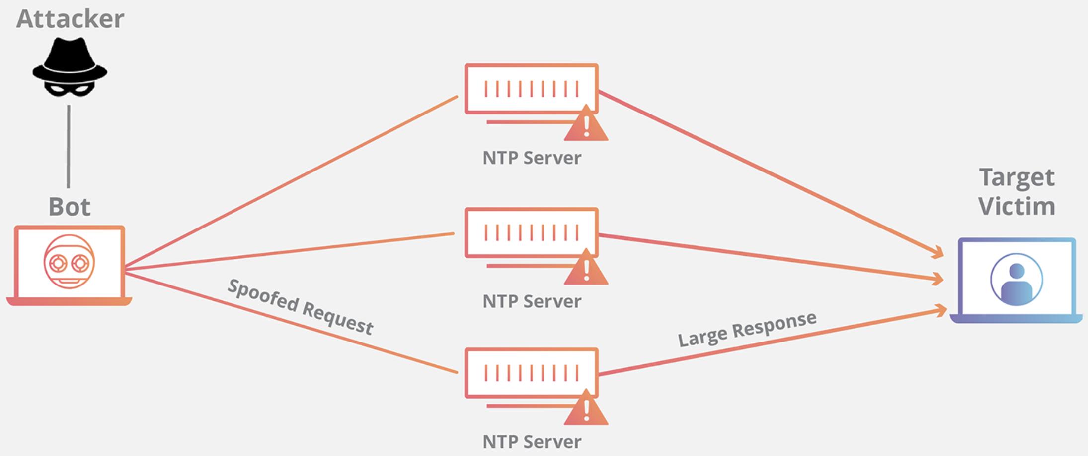
NTP Amplification Attack
Amplify the effect of NTP query
1 query vs a large response
monlist
600 IP addr
Notes:
https://www.cloudflare.com/learning/ddos/ntp-amplification-ddos-attack/
An NTP amplification attack can be broken down into four steps:
The attacker uses a botnet to send UDP packets with spoofed IP addresses to a NTP server which has its monlist command enabled. The spoofed IP address on each packet points to the real IP address of the victim.
Each UDP packet makes a request to the NTP server using its monlist command, resulting in a large response.
The server then responds to the spoofed address with the resulting data.
The IP address of the target receives the response and the surrounding network infrastructure becomes overwhelmed with the deluge of traffic, resulting in a denial-of-service.

Slide 65
NTP Amplification Attack
Amplify the effect of NTP query
1 query vs a large response
monlist
30+ bytes
600 IP addr
22,000 bytes of pkts
Notes:
https://www.cloudflare.com/learning/ddos/ntp-amplification-ddos-attack/
https://www.akamai.com/us/en/multimedia/documents/state-of-the-internet/ntp-amplification-threat-advisory.pdf
An NTP amplification attack can be broken down into four steps:
The attacker uses a botnet to send UDP packets with spoofed IP addresses to a NTP server which has its monlist command enabled. The spoofed IP address on each packet points to the real IP address of the victim.
Each UDP packet makes a request to the NTP server using its monlist command, resulting in a large response.
The server then responds to the spoofed address with the resulting data.
The IP address of the target receives the response and the surrounding network infrastructure becomes overwhelmed with the deluge of traffic, resulting in a denial-of-service.

Slide 66
NTP Amplification Attack
Solution
reduce the number of NTP servers that support monlist;
source IP verification – stop spoofed packets leaving network;
monlist
30+ bytes
600 IP addr
22,000 bytes of pkts
Notes:
https://www.cloudflare.com/learning/ddos/ntp-amplification-ddos-attack/
https://www.akamai.com/us/en/multimedia/documents/state-of-the-internet/ntp-amplification-threat-advisory.pdf
How is a NTP amplification attack mitigated?
For an individual or company running a website or service, mitigation options are limited. This comes from the fact that the individual’s server, while it might be the target, is not where the main effect of a volumetric attack is felt. Due to the high amount of traffic generated, the infrastructure surrounding the server feels the impact. The Internet Service Provider (ISP) or other upstream infrastructure providers may not be able to handle the incoming traffic without becoming overwhelmed. As a result, the ISP may blackhole all traffic to the targeted victim’s IP address, protecting itself and taking the target’s site off-line. Mitigation strategies, aside from offsite protective services like Cloudflare DDoS protection, are mostly preventative internet infrastructure solutions.
Disable monlist - reduce the number of NTP servers which support the monlist command.
A simple solution to patching the monlist vulnerability is to disable the command. All version of the NTP software prior to version 4.2.7 are vulnerable by default. By upgrading a NTP server to 4.2.7 or above, the command is disabled, patching the vulnerability. If upgrading is not possible, following the US-CERT instructions will allow a server’s admin to make the necessary changes.
Source IP verification – stop spoofed packets leaving the network.
Because the UDP requests being sent by the attacker’s botnet must have a source IP address spoofed to the victim’s IP address, a key component in reducing the effectiveness of UDP-based amplification attacks is for internet service providers (ISPs) to reject any internal traffic with spoofed IP addresses. If a packet is being sent from inside the network with a source address that makes it appear like it originated outside the network, it’s likely a spoofed packet and can be dropped. Cloudflare highly recommends that all providers implement ingress filtering, and at times will reach out to ISPs who are unknowingly taking part in DDoS attacks (in violation of BCP38) and help them realize their vulnerability.
The combination of disabling monlist on NTP servers and implementing ingress filtering on networks which presently allow IP spoofing is an effective way to stop this type of attack before it reaches its intended network.

Slide 67
Memcached Attack
Leverage Memcached servers a general-purpose distributed memory-caching system for speeding up websites and networks
Exploit memcached request that triggers a response with a large volume of data to target
Notes:
https://www.cloudflare.com/learning/ddos/memcached-ddos-attack/
*Memcached is a database caching system for speeding up websites and networks.
What is a memcached DDoS attack?
A memcached distributed denial-of-service (DDoS) attack is a type of cyber attack in which an attacker attempts to overload a targeted victim with internet traffic. The attacker spoofs requests to a vulnerable UDP memcached* server, which then floods a targeted victim with internet traffic, potentially overwhelming the victim’s resources. While the target’s internet infrastructure is overloaded, new requests cannot be processed and regular traffic is unable to access the internet resource, resulting in denial-of-service.
How does a memcached attack work?
A Memcached attacks operates similarly to all DDoS amplification attacks such as NTP amplification and DNS amplification. The attack works by sending spoofed requests to a vulnerable server, which then responds with a larger amount of data than the initial request, magnifying the volume of traffic.
Memcached amplification can be thought of in the context of a malicious teenager calling a restaurant and saying "I’ll have one of everything, please call me back and tell me my whole order." When the restaurant asks for a callback number, the number given is the targeted victim’s phone number. The target then receives a call from the restaurant with a lot of information that they didn’t request.
This method of amplification attack is possible because memcached servers have the option to operate using the UDP protocol. UDP is a network protocol that allows for the sending of data without first getting what’s known as a handshake, which is a network process where both sides agree to the communication. UDP is utilized because the targeted host is never consulted on whether or not they’re willing to receive the data, allowing for a massive amount of data to be sent to the target without their prior consent.

Slide 68
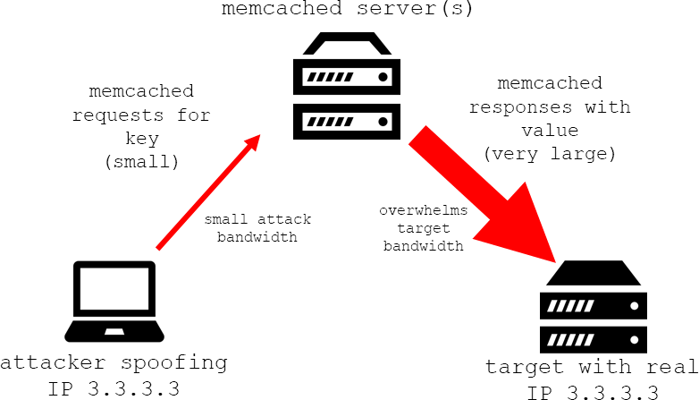
Memcached Attack
Exploit memcached request that triggers a response with a large volume of data to target
Notes:
https://www.cloudflare.com/learning/ddos/memcached-ddos-attack/
https://cloudshark.io/articles/memcached-memcrashed-ddos-attack/
*Memcached is a database caching system for speeding up websites and networks.
What is a memcached DDoS attack?
A memcached distributed denial-of-service (DDoS) attack is a type of cyber attack in which an attacker attempts to overload a targeted victim with internet traffic. The attacker spoofs requests to a vulnerable UDP memcached* server, which then floods a targeted victim with internet traffic, potentially overwhelming the victim’s resources. While the target’s internet infrastructure is overloaded, new requests cannot be processed and regular traffic is unable to access the internet resource, resulting in denial-of-service.
How does a memcached attack work?
A Memcached attacks operates similarly to all DDoS amplification attacks such as NTP amplification and DNS amplification. The attack works by sending spoofed requests to a vulnerable server, which then responds with a larger amount of data than the initial request, magnifying the volume of traffic.
Memcached amplification can be thought of in the context of a malicious teenager calling a restaurant and saying "I’ll have one of everything, please call me back and tell me my whole order." When the restaurant asks for a callback number, the number given is the targeted victim’s phone number. The target then receives a call from the restaurant with a lot of information that they didn’t request.
This method of amplification attack is possible because memcached servers have the option to operate using the UDP protocol. UDP is a network protocol that allows for the sending of data without first getting what’s known as a handshake, which is a network process where both sides agree to the communication. UDP is utilized because the targeted host is never consulted on whether or not they’re willing to receive the data, allowing for a massive amount of data to be sent to the target without their prior consent.

Slide 69
Memcached Attack
Attack principle
preload large data to Memcached server;
spoof request to preloaded data from target;
Notes:
A memcached attack occurs in 4 steps:
An attacker implants a large payload* of data on an exposed memcached server.
Next the attacker spoofs an HTTP GET request with the IP address of the targeted victim.
The vulnerable memcached server that receives the request, which is trying to be helpful by responding, sends a large response to the target.
The targeted server or its surrounding infrastructure is unable to process the large amount of data sent from the memcached server, resulting in overload and denial-of-service to legitimate requests.

Slide 70
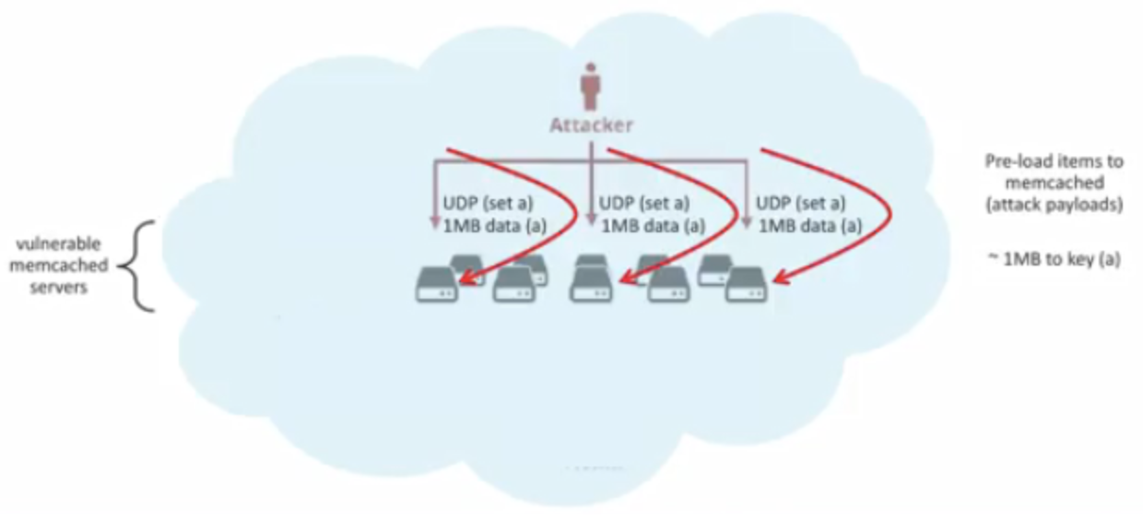
Memcached Attack
Attack principle
preload large data to Memcached server;
Notes:
A memcached attack occurs in 4 steps:
An attacker implants a large payload* of data on an exposed memcached server.
Next the attacker spoofs an HTTP GET request with the IP address of the targeted victim.
The vulnerable memcached server that receives the request, which is trying to be helpful by responding, sends a large response to the target.
The targeted server or its surrounding infrastructure is unable to process the large amount of data sent from the memcached server, resulting in overload and denial-of-service to legitimate requests.

Slide 71
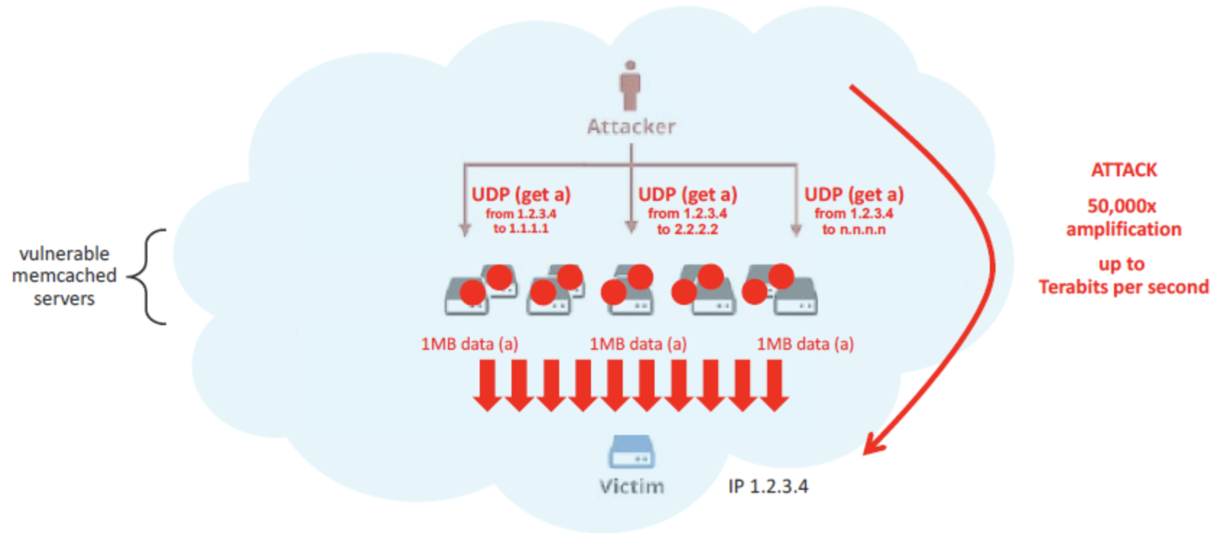
Memcached Attack
Attack principle
spoof request to preloaded data from target;
Notes:
A memcached attack occurs in 4 steps:
An attacker implants a large payload* of data on an exposed memcached server.
Next the attacker spoofs an HTTP GET request with the IP address of the targeted victim.
The vulnerable memcached server that receives the request, which is trying to be helpful by responding, sends a large response to the target.
The targeted server or its surrounding infrastructure is unable to process the large amount of data sent from the memcached server, resulting in overload and denial-of-service to legitimate requests.

Slide 72
Memcached Attack
Solution
disable UDP on Memcached server;
firewall Memcached server;
source IP verification;
flush_all command to Memcached server;
Notes:
How can a memcached attack be mitigated?
Disable UDP - For memcached servers, make sure to disable UDP support if you do not need it. By default, memcached has UDP support enabled, potentially leaving a server vulnerable.
Firewall memcached servers - by firewalling memcached servers from the Internet, system administrators are able to use UDP for memcached if necessary without exposure.
Prevent IP spoofing - as long as IP addresses can be spoofed, DDoS attacks can make use of the vulnerability to direct traffic to a victim's network. Preventing IP spoofing is a larger solution that cannot be implemented by any particular system administrator, and it requires transit providers to not allow any packets to leave their network that have a source IP address originating outside the network. In other words, companies such as internet service providers (ISPs) must filter traffic such that the packets that leave their network are not allowed to pretend to be from a different network somewhere else. If all major transit providers implemented this type of filtration, spoofing-based attacks would disappear overnight.
Develop software with reduced UDP responses - another way to eliminate amplification attacks is to remove the amplification factor to any incoming request; If the response data sent as a result of a UDP request is smaller than or equal to the initial request, amplification is no longer possible.
These attacks can be very large and what we discovered is that as a countermeasure to the attack, you can send a simple memcached “flush_all” command back to the originating attacking server, defeating the current attack by invalidating its cache and making its malicious payloads useless, until it is reloaded by the attacker.
You can progress through the attacking sip list with a single “flush_all” command to each attacker. The countermeasure invalidate packet has been tested on live attack servers and appears to be 100% effective.

Slide 73
SSDP Attack
Leverage Simple Service Discovery Protocol (SSDP)
Exploit Universal Plug and Play (UPnP) networking protocols that trigger UPnP devices to respond with a complete list of all services it has to offer
Notes:
https://www.cloudflare.com/learning/ddos/ssdp-ddos-attack/

Slide 74
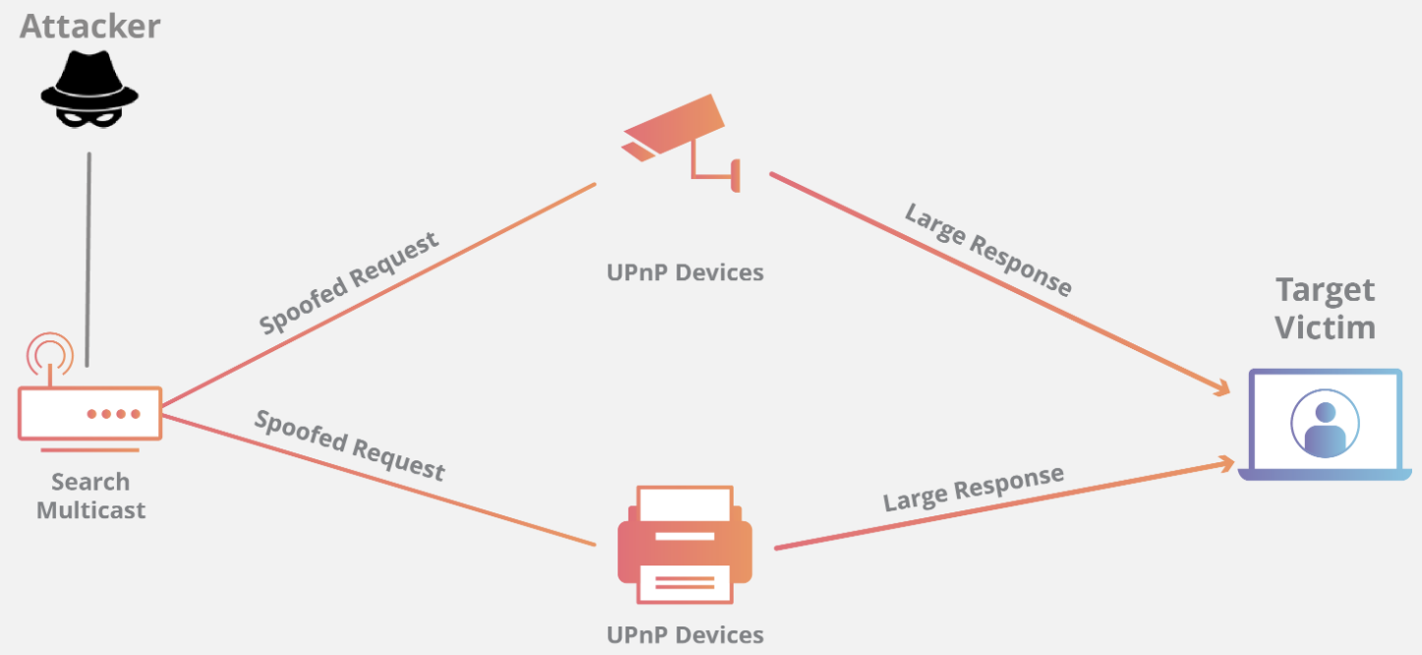
SSDP Attack
Exploit SSDP and UpnP
Notes:
https://www.cloudflare.com/learning/ddos/ssdp-ddos-attack/

Slide 75
SSDP Attack
Attack principle
1. the attacker conducts a scan looking for plug-and-play devices that can be utilized as amplification factors;
Notes:
https://www.cloudflare.com/learning/ddos/ssdp-ddos-attack/

Slide 76
SSDP Attack
Attack principle
1. the attacker conducts a scan looking for plug-and-play devices that can be utilized as amplification factors;
2. as the attacker discovers networked devices, they create a list of all the devices that respond;
Notes:
https://www.cloudflare.com/learning/ddos/ssdp-ddos-attack/

Slide 77
SSDP Attack
Attack principle
1. the attacker conducts a scan looking for plug-and-play devices that can be utilized as amplification factors;
2. as the attacker discovers networked devices, they create a list of all the devices that respond;
3. the attacker creates a UDP packet with the spoofed IP address of the targeted victim.
Notes:
https://www.cloudflare.com/learning/ddos/ssdp-ddos-attack/

Slide 78
SSDP Attack
Attack principle
4. the attacker then uses a botnet to send a spoofed discovery packet to each plug-and-play device with a request for as much data as possible by setting certain flags, specifically ssdp:rootdevice or ssdp:all;
Notes:
https://www.cloudflare.com/learning/ddos/ssdp-ddos-attack/

Slide 79
SSDP Attack
Attack principle
5. as a result, each device will send a reply to the targeted victim with an amount of data up to about 30 times larger than the attacker’s request;
Notes:
https://www.cloudflare.com/learning/ddos/ssdp-ddos-attack/

Slide 80
SSDP Attack
Attack principle
5. as a result, each device will send a reply to the targeted victim with an amount of data up to about 30 times larger than the attacker’s request;
6. the target then receives a large volume of traffic from all the devices and becomes overwhelmed, potentially resulting in denial-of-service to legitimate traffic;
Notes:
https://www.cloudflare.com/learning/ddos/ssdp-ddos-attack/

Slide 81
SSDP Attack
Solution
block incoming UDP traffic on port 1900 at the firewall;
Notes:
https://www.cloudflare.com/learning/ddos/ssdp-ddos-attack/

Slide 82
asymmetric DDoS attack
exploit traffic amplifier so far
Notes:
https://www.radware.com/security/ddos-knowledge-center/ddospedia/asymmetric-attack

Slide 83
Smurf Attack
Attack with an ICMP Echo Request with spoofed source IP address of the targeted server and destination IP address of an IP broadcast address
1 ICMP Echo Request
Spoofed Src: DDos Target
Dest: brdct addr
3 ICMP Echo Reply
Dest: DDos Target
router/firewall
DDoS
Target
DDoS
Source
Notes:
https://www.cloudflare.com/learning/ddos/smurf-ddos-attack/
https://searchnetworking.techtarget.com/tip/Router-Expert-Smurf-fraggle-attack-defense-using-SACLs
Here's How a Smurf attack works:
First the Smurf malware builds a spoofed packet that has its source address set to the real IP address of the targeted victim.
The packet is then sent to an IP broadcast address of a router or firewall, which in turn sends requests to every host device address inside the broadcasting network, increasing the number of requests by the number of networked devices on the network.
Each device inside the network receives the request from the broadcaster and then responds to the spoofed address of the target with an ICMP Echo Reply packet.
The target victim then receives a deluge of ICMP Echo Reply packets, potentially becoming overwhelmed and resulting in denial-of-service to legitimate traffic.

Slide 84
DNS Amplification Attack
Attack with an ANY-type DNS query with spoofed source IP address of the targeted server
EDNS: Extension Mechanisms for DNS sends DNS data in larger UDP packets
DNS Query
Spoofed SrcIP: DDos Target
(60 bytes)
EDNS Reponse
(3000 bytes)
DDoS
Source
DNS
Server
DDoS
Target
Notes:
https://www.cloudflare.com/learning/ddos/dns-amplification-ddos-attack/
An "open DNS resolver" is a DNS server that's willing to resolve recursive DNS lookups for anyone on the internet.
https://en.wikipedia.org/wiki/Extension_Mechanisms_for_DNS
Extension mechanism for DNS (EDNS, or EDNS(0)) gives us a mechanism to send DNS data in larger packets over UDP.

Slide 85
NTP Amplification Attack
Amplify the effect of NTP query
1 query vs a large response
monlist
30+ bytes
600 IP addr
22,000 bytes of pkts
Notes:
https://www.cloudflare.com/learning/ddos/ntp-amplification-ddos-attack/
https://www.akamai.com/us/en/multimedia/documents/state-of-the-internet/ntp-amplification-threat-advisory.pdf
An NTP amplification attack can be broken down into four steps:
The attacker uses a botnet to send UDP packets with spoofed IP addresses to a NTP server which has its monlist command enabled. The spoofed IP address on each packet points to the real IP address of the victim.
Each UDP packet makes a request to the NTP server using its monlist command, resulting in a large response.
The server then responds to the spoofed address with the resulting data.
The IP address of the target receives the response and the surrounding network infrastructure becomes overwhelmed with the deluge of traffic, resulting in a denial-of-service.

Slide 86
Memcached Attack
Attack principle
preload large data to Memcached server;
Notes:
A memcached attack occurs in 4 steps:
An attacker implants a large payload* of data on an exposed memcached server.
Next the attacker spoofs an HTTP GET request with the IP address of the targeted victim.
The vulnerable memcached server that receives the request, which is trying to be helpful by responding, sends a large response to the target.
The targeted server or its surrounding infrastructure is unable to process the large amount of data sent from the memcached server, resulting in overload and denial-of-service to legitimate requests.

Slide 87
Memcached Attack
Attack principle
spoof request to preloaded data from target;
Notes:
A memcached attack occurs in 4 steps:
An attacker implants a large payload* of data on an exposed memcached server.
Next the attacker spoofs an HTTP GET request with the IP address of the targeted victim.
The vulnerable memcached server that receives the request, which is trying to be helpful by responding, sends a large response to the target.
The targeted server or its surrounding infrastructure is unable to process the large amount of data sent from the memcached server, resulting in overload and denial-of-service to legitimate requests.

Slide 88
SSDP Attack
Exploit SSDP and UpnP
Notes:
https://www.cloudflare.com/learning/ddos/ssdp-ddos-attack/

Slide 89
asymmetric DDoS attack
computation asymmetry:
server costs more computation resources than attacker for a service request
Notes:
https://www.radware.com/security/ddos-knowledge-center/ddospedia/asymmetric-attack

Slide 90
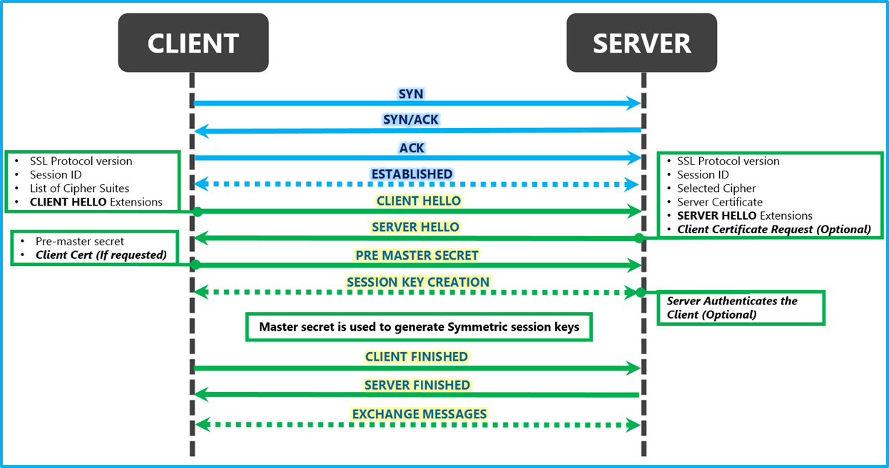
Secure Connection
TCP
handshake
TLS
handshake
msg transmission
connection
termination
FIN
FIN, ACK
ACK

Slide 91

SSL/TLS Handshake
TCP
handshake
TLS
handshake
msg transmission
connection
termination
FIN
FIN, ACK
ACK

Slide 92
SSL/TLS Flood
Exploit SSL/TLS handshake requests to drain server resources
Client Hello
Web
Server
Server Hello (pub-key)
RSA
Encrypt
Client key exchange
RSA
Decrypt
Notes:
https://www.thesslstore.com/blog/what-is-an-ssl-flood/
An SSL Flood or SSL Renegotiation attack takes advantage of the processing power needed to negotiate a secure TLS connection on the server side. It either sends copious amounts of garbage data to the server or constantly asks to renegotiate the connection, thus straining the server’s resources beyond its limits and knocking it offline.

Slide 93
SSL/TLS Flood
Exploit SSL/TLS handshake requests to drain server resources
RSA-enc speed ≈ 10x RSA-dec speed
Single machine can bring down ten web servers
Client Hello
Web
Server
Server Hello (pub-key)
RSA
Encrypt
Client key exchange
RSA
Decrypt
Notes:
https://www.thesslstore.com/blog/what-is-an-ssl-flood/
An SSL Flood or SSL Renegotiation attack takes advantage of the processing power needed to negotiate a secure TLS connection on the server side. It either sends copious amounts of garbage data to the server or constantly asks to renegotiate the connection, thus straining the server’s resources beyond its limits and knocking it offline.

Slide 94
HTTP Flood
Command attackers to:
Complete real TCP connection
Complete TLS Handshake
GET large image or other content
Notes:
https://www.cloudflare.com/learning/ddos/http-flood-ddos-attack/

Slide 95
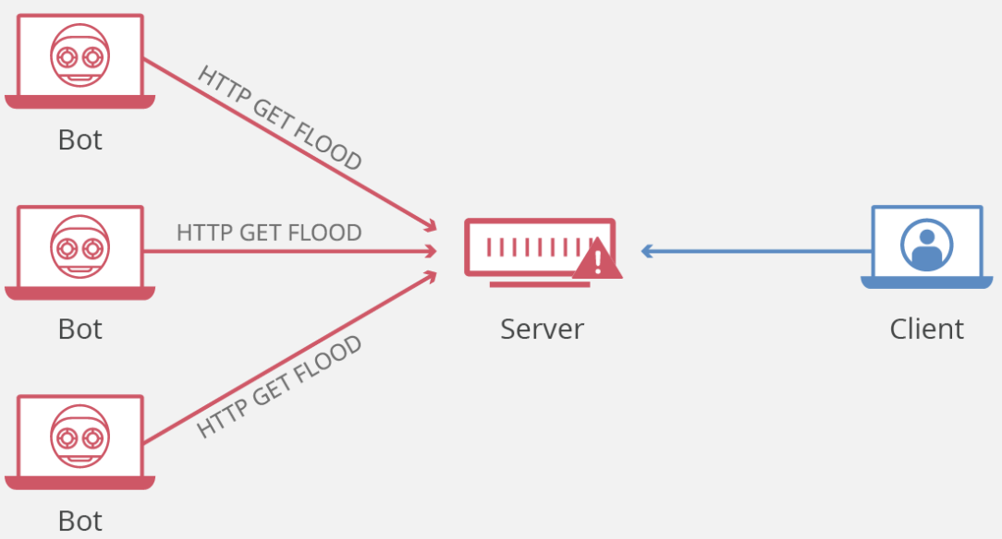
HTTP Flood
Command attackers to:
Complete real TCP connection
Complete TLS Handshake
GET large image or other content
Notes:
https://www.cloudflare.com/learning/ddos/http-flood-ddos-attack/

Slide 96
HTTP Flood
Command attackers to:
Complete real TCP connection
Complete TLS Handshake
GET large image or other content
Notes:
https://www.cloudflare.com/learning/ddos/http-flood-ddos-attack/
HTTP GET attack - in this form of attack, multiple computers or other devices are coordinated to send multiple requests for images, files, or some other asset from a targeted server. When the target is inundated with incoming requests and responses, denial-of-service will occur to additional requests from legitimate traffic sources.

Slide 97
HTTP Flood
Command attackers to:
Complete real TCP connection
Complete TLS Handshake
POST large image or other content
Notes:
https://www.cloudflare.com/learning/ddos/http-flood-ddos-attack/
HTTP POST attack - typically when a form is submitted on a website, the server must handle the incoming request and push the data into a persistence layer, most often a database. The process of handling the form data and running the necessary database commands is relatively intensive compared to the amount of processing power and bandwidth required to send the POST request. This attack utilizes the disparity in relative resource consumption, by sending many post requests directly to a targeted server until it's capacity is saturated and denial-of-service occurs.

Slide 98
HTTP Flood
Command attackers to:
Complete real TCP connection
Complete TLS Handshake
GET/POST large image or other content
Solution:
block or rate limit attacking source
Notes:
https://www.cloudflare.com/learning/ddos/http-flood-ddos-attack/

Slide 99
HTTP Flood
Command attackers to:
Complete real TCP connection
Complete TLS Handshake
GET/POST large image or other content
Solution:
block or rate limit attacking source
Notes:
https://www.cloudflare.com/learning/ddos/http-flood-ddos-attack/
Rate control against large volume of traffic that occupies a long connection;

Slide 100
Fragmented HTTP Flood
Establish a valid HTTP connection
Split HTTP packets into tiny fragments
Send fragments to the target as slowly as it allows before it times out
Notes:
Still occupy a long connection, yet with a low rate
Fragmented HTTP Flood
In this example of a sophisticated attack on a known loophole, BOTs with a valid IP are used to establish a valid HTTP connection with a web server. Then, HTTP packets are split by the bot into tiny fragments and sent to the target as slowly as it allows before it times out. This method allows the attackers to keep a connection active for a long time without alerting any defense mechanisms.
An attacker can use one BOT to initiate several undetected, extended and resource consuming sessions. Popular web servers like Apache do not have effective timeout mechanisms. This is a DDoS security loophole that can be exploited with a few BOTs to stop web services.

Slide 101
Fragmented HTTP Flood
Establish a valid HTTP connection
Split HTTP packets into tiny fragments
Send fragments to the target as slowly as it allows before it times out
keep a resource-consuming connection active for a long time;
Notes:
Fragmented HTTP Flood
In this example of a sophisticated attack on a known loophole, BOTs with a valid IP are used to establish a valid HTTP connection with a web server. Then, HTTP packets are split by the bot into tiny fragments and sent to the target as slowly as it allows before it times out. This method allows the attackers to keep a connection active for a long time without alerting any defense mechanisms.
An attacker can use one BOT to initiate several undetected, extended and resource consuming sessions. Popular web servers like Apache do not have effective timeout mechanisms. This is a DDoS security loophole that can be exploited with a few BOTs to stop web services.

Slide 102
Payment DDoS
Payment DDoS:
low rate at each merchant
high rate at acquiring bank
Acquiring
Bank
Merchant A
Merchant B
Merchant C
Dummy
Purchase
Requests

Slide 103
asymmetric DDoS attack
bring down the entire server so far
Notes:
https://www.radware.com/security/ddos-knowledge-center/ddospedia/asymmetric-attack

Slide 104

asymmetric DDoS attack
bring down the entire server so far
weakest link?!
Notes:
https://www.radware.com/security/ddos-knowledge-center/ddospedia/asymmetric-attack

Slide 105
asymmetric DDoS attack
bring down the entire server so far
weakest link from inside
Notes:
https://www.radware.com/security/ddos-knowledge-center/ddospedia/asymmetric-attack

Slide 106
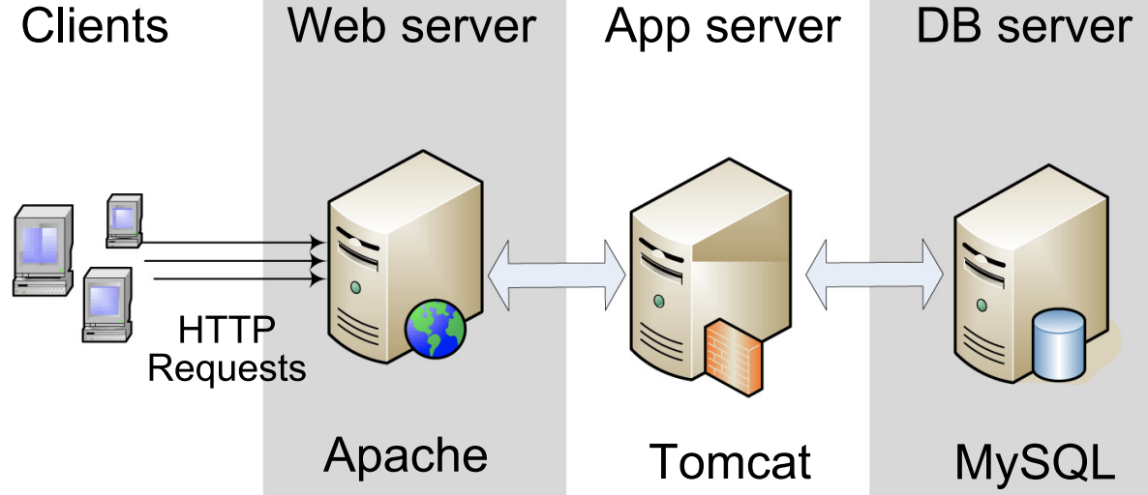
Tail Attack
Tail attacks on n-tier web applications
Identify weakest link across tiers
http://csc.lsu.edu/~qywang/papers/TOIT-Wang-2019.pdf

Slide 107
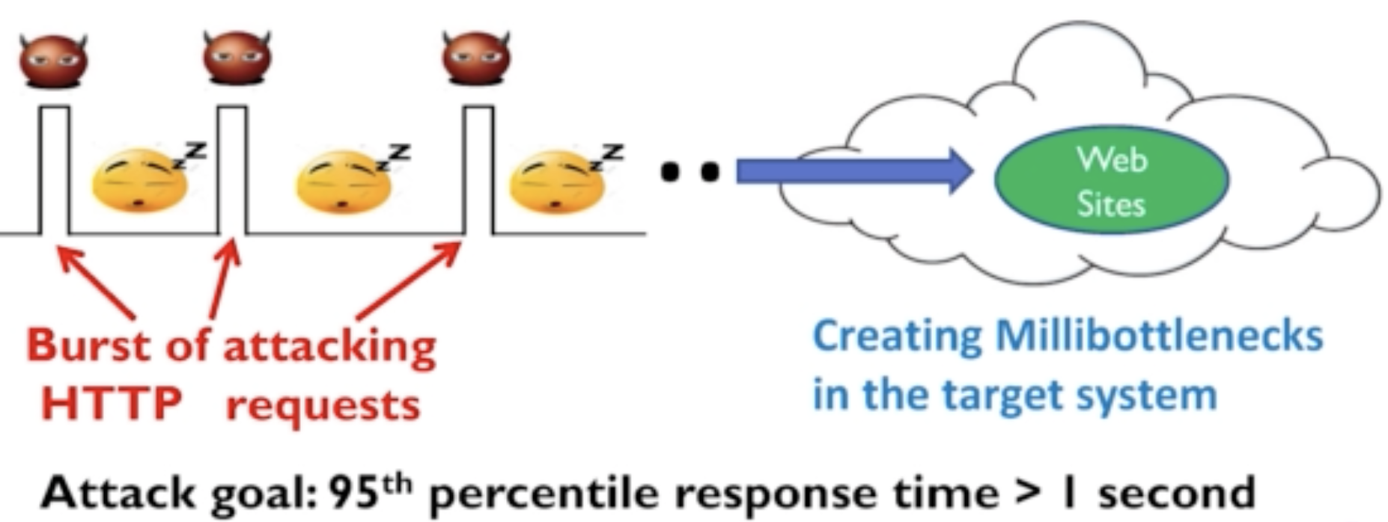
Tail Attack
Tail attacks on n-tier web applications
Saturate weakest link w/ low-rate traffic
https://dl.acm.org/doi/10.1145/3133956.3133968

Slide 108
asymmetric DDoS attack
bring down the entire server so far
weakest link from outside
Notes:
https://www.radware.com/security/ddos-knowledge-center/ddospedia/asymmetric-attack

Slide 109
SDN CrossPath Attack
Disrupt SDN control channel via shared links
Do not directly attack SDN controller
Instead, block control messages with attacking traffic
https://www.usenix.org/sites/default/files/conference/protected-files/sec19_slides_cao.pdf

Slide 110
SDN CrossPath Attack
SDN: Software-Defined Networking
separate control and data planes
take centralized network control
enable network programmability

Slide 111
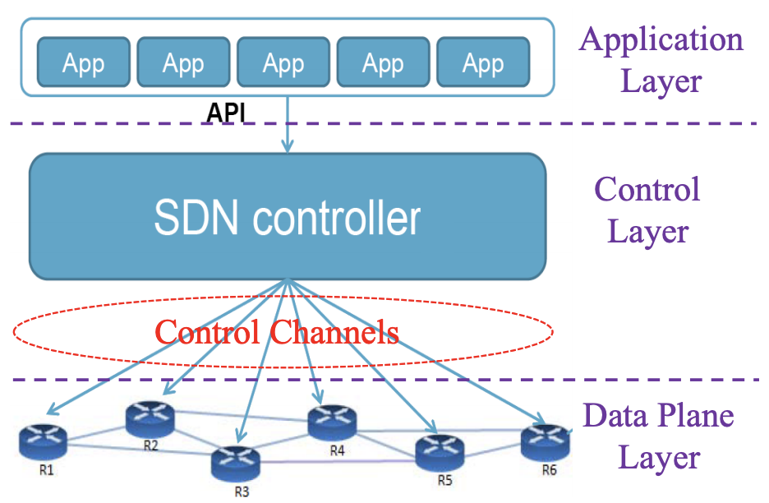
SDN CrossPath Attack
Three-layer architecture

Slide 112
SDN CrossPath Attack
Three-layer architecture
deliver all control traffic;
issue rules from controller to switches;
report stats from switches to controller;
guarantee security and reliability;

Slide 113
SDN CrossPath Attack
Three-layer architecture
require too many direct links between controller and switch!

Slide 114
SDN CrossPath Attack
Three-layer architecture
require too many direct links between controller and switch!
limited scalability;

Slide 115
SDN CrossPath Attack
Introduce shared links
relay control traffic via data paths;

Slide 116
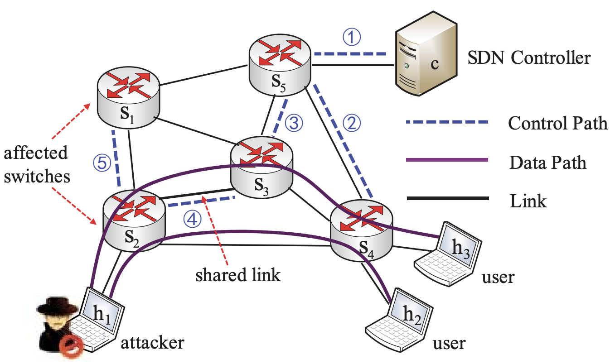
SDN CrossPath Attack
Introduce shared links

Slide 117
SDN CrossPath Attack
Introduce shared links: control&data

Slide 118
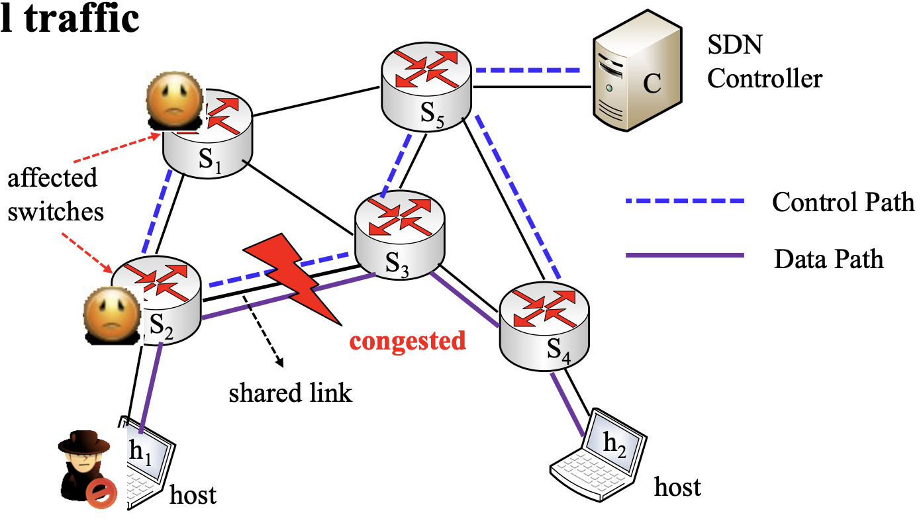
SDN CrossPath Attack
Send data traffic to congest shared links
DDoS control traffic

Slide 119
DDoS attacks so far
Notes:
https://www.radware.com/security/ddos-knowledge-center/ddospedia/asymmetric-attack

Slide 120
DDoS defenses
Notes:
https://www.radware.com/security/ddos-knowledge-center/ddospedia/asymmetric-attack

Slide 121
DDoS defenses
make server harder to be attacked
Notes:
https://www.radware.com/security/ddos-knowledge-center/ddospedia/asymmetric-attack

Slide 122
DDoS defenses
make server harder to be attacked:
enrich server with more resources;
Notes:
https://www.radware.com/security/ddos-knowledge-center/ddospedia/asymmetric-attack

Slide 123
DDoS defenses
make server harder to be attacked:
enrich server with more resources;
leverage the sources of others;
Notes:
https://www.radware.com/security/ddos-knowledge-center/ddospedia/asymmetric-attack

Slide 124
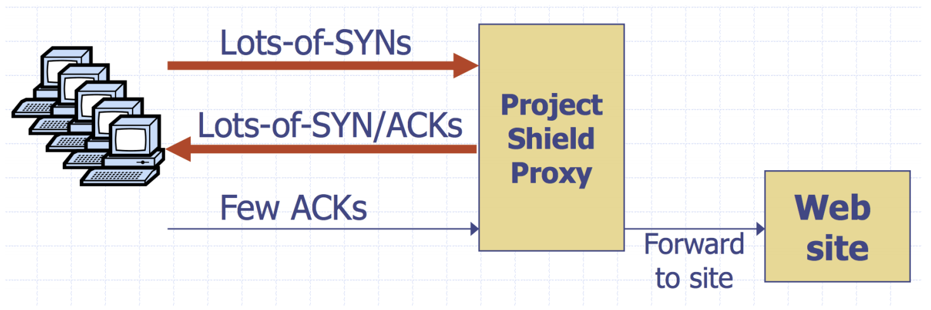
Google Project Shield
Use Google bandwidth to shield vulnerable websites

Slide 125
DDoS defenses
make server harder to be attacked:
detect and filter attack traffic
Notes:
https://www.radware.com/security/ddos-knowledge-center/ddospedia/asymmetric-attack

Slide 126
DDoS defenses
make server harder to be attacked:
detect and filter attack traffic
with spoofed IP addresses
Notes:
https://www.radware.com/security/ddos-knowledge-center/ddospedia/asymmetric-attack

Slide 127
Ingress Filtering
How to find packet origin?

Slide 128
Ingress Filtering
How to find packet origin?
ISP
Internet
Notes:
Packet enter internet via ISP

Slide 129
Ingress Filtering
How to find packet origin?
Ingress filtering policy:
ISP only forwards packets with legitimate source IP
ISP
Internet
Notes:
Packet enter internet via ISP

Slide 130
Ingress Filtering
Implementation challenges:
All ISPs need to do this — requires global coordination:
If 10% of networks don’t implement, there’s no defense;
No incentive for an ISP to implement — doesn’t affect them;
Ingress filtering policy:
ISP only forwards packets with legitimate source IP
Notes:
Packet enter internet via ISP

Slide 131
Ingress Filtering
Implementation challenges:
As of 2017 (from CAIDA):
33% of autonomous systems allow spoofing;
23% of announced IP address space allow spoofing;
Ingress filtering policy:
ISP only forwards packets with legitimate source IP
Notes:
Packet enter internet via ISP

Slide 132
Ingress Filtering
Can transit AS verify packet origin?

Slide 133
Ingress Filtering
Can transit AS verify packet origin? No
Routing protocols care about only destination IP addresses
R₁
R₃
R₂
R₄
dest
Source AS
Transit AS
Dest AS

Slide 134
Ingress Filtering
Can transit AS verify packet origin? Yes
Routing protocols care about only destination IP addresses
Were routing protocols modified…
R₁
R₃
R₂
R₄
dest
Source AS
Transit AS
Dest AS

Slide 135
Traceback
Goal
given set of attack packets
determine path to source
How
change routers to record info in packets

Slide 136
Traceback
Goal
given set of attack packets
determine path to source
How
change routers to record info in packets
Assumptions
trusted routers
sufficient packets to track
stable route from attacker to victim

Slide 137
Traceback
Write path into packets
router adds its own IP address to packet
victim reads path from packet

Slide 138
Traceback
Write path into packets
router adds its own IP address to packet
victim reads path from packet
Limitations
requires space in packet
path can be long
no extra fields in current IP format (changes to packet format too much to expect)

Slide 139
Traceback
Sample and Merge
store one link in each
packet;
router probabilistically
stores own address;
fixed space regardless of
path length;
A₁
A₂
A₃
A₄
A₅
R₆
R₇
R₈
R₉
R₁₀
R₁₂
V

Slide 140
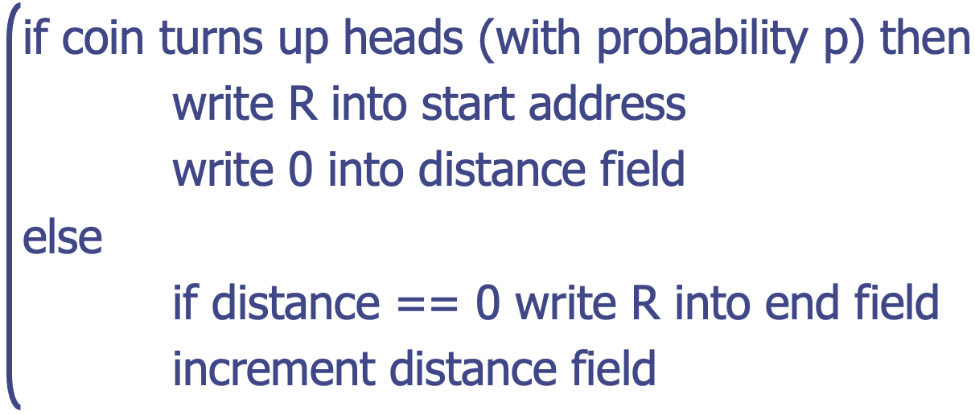
Traceback
Edge Sampling: fields into packet
edge: start and end IP addresses
distance: no. of hops since edge stored
Marking procedure of router R

Slide 141
Traceback
Packet received
R₁ receives packet from source or another router;
packet contains space for start, end, distance;
packet
s
e
d
R₁
R₂
R₃

Slide 142
Traceback
Begin writing edge
R₁ chooses to write start of edge;
sets distance to 0;
packet
R₁
0
R₁
R₂
R₃

Slide 143
Traceback
Finish writing edge
R₂ chooses not to overwrite edge;
distance is 0: write end of edge, increment distance to 1;
packet
R₁
R₂
1
R₁
R₂
R₃

Slide 144
Traceback
Increment distance
R₃ chooses not to overwrite edge;
distance>0: increment distance to 2;
packet
R₁
R₂
2
R₁
R₂
R₃

Slide 145
Traceback
Increment distance
R₃ chooses not to overwrite edge;
distance>0: increment distance to 2;
Were routing protocols modified…
packet
R₁
R₂
2
R₁
R₂
R₃

Slide 146
Path Validation
PoC: Proof of Consent
certify the provider’s consent to carry traffic along the path
PoP: Proof of Provenance
allow upstream nodes to prove to downstream nodes that they carried the packet

Slide 147
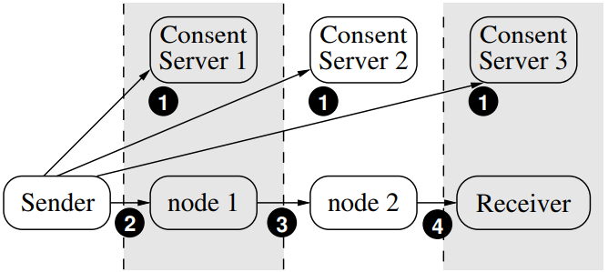
Path Validation

Slide 148
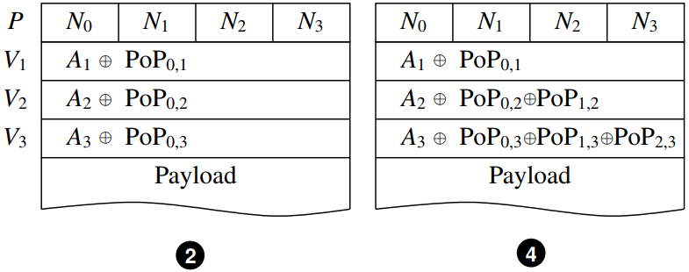
Path Validation
https://cs.nyu.edu/~mwalfish/papers/icing-conext11.pdf

Slide 149
Path Validation
Were routing protocols modified…
https://cs.nyu.edu/~mwalfish/papers/icing-conext11.pdf

Slide 150
Alibi Routing
How to verify that a packet DO NOT transmit via a specific AS?

Slide 151
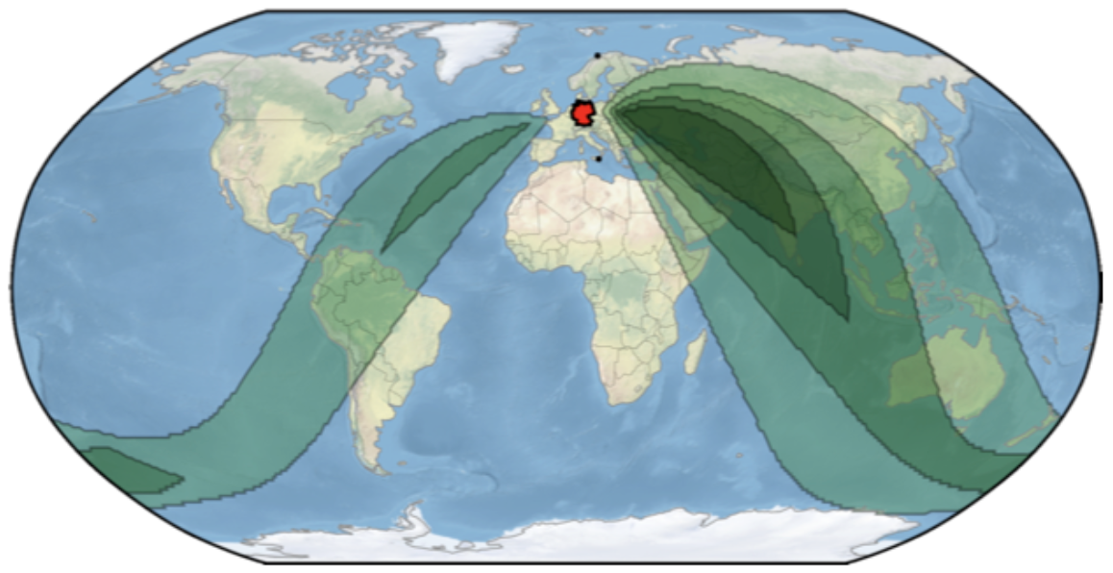
Alibi Routing
How to verify that a packet DO NOT transmit via a specific AS?
source
avoiding AS
destination
https://conferences.sigcomm.org/sigcomm/2015/pdf/papers/p611.pdf

Slide 152
Alibi Routing
Introduce proof waypoint
source
avoiding AS
destination

Slide 153
Alibi Routing
Introduce proof waypoint such that
packets cannot transmit via both avoiding area and proof waypoint in a given time limit
source
avoiding AS
destination

Slide 154
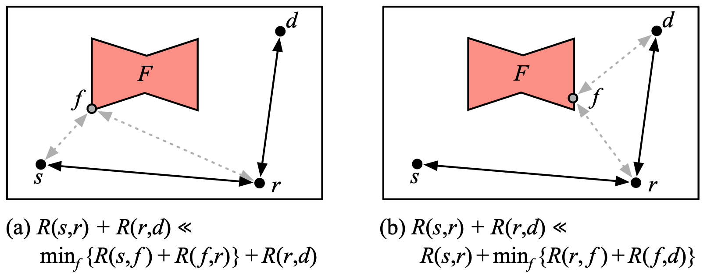
Alibi Routing
Introduce proof waypoint such that
packets cannot transmit via both avoiding area and proof waypoint in a given time limit

Slide 155
Alibi Routing
Introduce proof waypoint such that
packets cannot transmit via both avoiding area and proof waypoint in a given time limit
Were routing protocols modified…

Slide 156
DDoS defenses
make attacker harder to attack
Notes:
https://www.radware.com/security/ddos-knowledge-center/ddospedia/asymmetric-attack

Slide 157
DDoS defenses
make attacker harder to attack
cost more resources from attacker
Notes:
https://www.radware.com/security/ddos-knowledge-center/ddospedia/asymmetric-attack

Slide 158
Client Puzzles
Idea
what if we force every client to do moderate amount of work for every connection they make?
Example
server sends: C
client: given challenge C find X s.t.
LSB_{n}(SHA-1(C||X)) = 0^{n}
Notes:
s.t.: subject to

Slide 159
Client Puzzles
Benefits
invoked upon attack detection;
can tune n in reactive to amount of attack traffic;
Limitations
require changes to protocols, clients, and servers;
during attack, hurts low-power legitimate clients (e.g., phones);
Notes:
s.t.: subject to

Slide 160
CAPTCHA
Completely Automated Public Turing test to tell Computers and Humans Apart

Slide 161
CAPTCHA
Completely Automated Public Turing test to tell Computers and Humans Apart
challenge–response test used in computing to determine whether or not the user is human
Notes:
A CAPTCHA is a type of challenge–response test used in computing to determine whether or not the user is human.

Slide 162

CAPTCHA
Completely Automated Public Turing test to tell Computers and Humans Apart
challenge–response test used in computing to determine whether or not the user is human
Notes:
A CAPTCHA is a type of challenge–response test used in computing to determine whether or not the user is human.

Slide 163

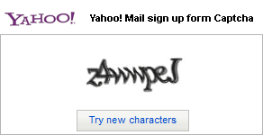

CAPTCHA
Text, image, audio…

Slide 164
CAPTCHA
Vulnerable to auto-identification

Slide 165

CAPTCHA
Adversarial CAPTCHA
shorturl.at/bBVY0

Slide 166
dndyjmzxixi

Slide 167
qydszsyd✨

Slide 168
?

Slide 169
Readings
What is a DDoS Attack?
by CLOUDFLARE
Protocol Security and DoS Attacks
by Dan Boneh and Zakir Durumeric
Denial of Service Attacks
by Zulfikar Ramzan

Slide 170
Thank You
be on the road
Notes:
Run your own race.

